Slide 1

Go, change the world
RV College of
Engineering
Introduction to Cloud Computing –Unit 2:
22MCN1B2T
By
Prof Srividya M S,
Department of CSE,
RVCE

Slide 2
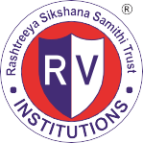
RV College of
Engineering
Go, change the world
UNIT-1:
Introduction to Cloud Computing:
Cloud Computing in a Nutshell,
System Model for Distributed and Cloud Computing,
Roots of Cloud Computing,
Grid and Cloud,
Layers and Types of Clouds,
Desired Features of a Cloud,
Basic Principles of Cloud Computing,
Challenges and Risks,
Service Models

Slide 3
CLOUD COMPUTING IN A NUTSHELL
When plugging an electric appliance into an outlet, we care neither how electric power is generated nor how it gets to that outlet. This is possible because electricity is virtualized; that is, it is readily available from a wall socket that hides power generation stations and a huge distribution grid.
In addition, an important aim of these technologies has been delivering computing as a utility.
Utility computing describes a business model for on-demand delivery of computing power; consumers pay providers based on usage (“pay-as-you-go”), similar to the way in which we currently obtain services from traditional public utility services such as water, electricity, gas, and telephony

Slide 4
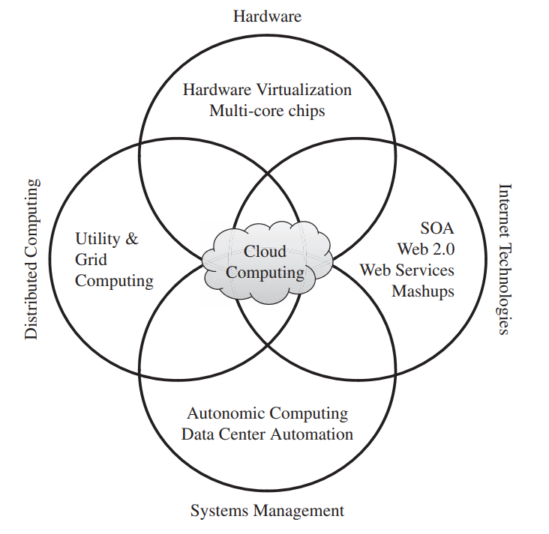
ROOTS OF CLOUD COMPUTING
The roots of clouds computing by observing the advancement of several technologies, especially in:
Hardware (virtualization, multi-core chips),
Internet technologies (Web services, service-oriented architectures, Web 2.0),
Distributed computing (clusters, grids), and
Systems management (autonomic computing, data center automation).

Slide 5
SOA, Web Services, Web 2.0, and Mashups
Web services can glue together applications running on different messaging product platforms, enabling information from one application to be made available to others, and enabling internal applications to be made available over the Internet.
WS standards have been created on top of existing ubiquitous technologies such as HTTP and XML, thus providing a common mechanism for delivering services, making them ideal for implementing a service-oriented architecture (SOA)
In a SOA, software resources are packaged as “services,” which are well-defined, self contained modules that provide standard business functionality and are independent of the state or context of other services.
This concept of gluing services initially focused on the enterprise Web, but gained space in the consumer realm as well, especially with the advent of Web 2.0.
In the consumer Web, information and services act as building blocks of complex compositions, called service mashups.

Slide 6
Grid and Utility Computing
Grid computing enables aggregation of distributed resources and transparently access to them.
Grids allow distributed resources to be “discovered, accessed, allocated, monitored, accounted for, and billed for, etc., and in general managed as a single virtual system.”
A key aspect of the grid vision realization has been building standard Web services-based protocols
The Open Grid Services Architecture (OGSA) addresses this need for standardization by defining a set of core capabilities and behaviors that address key concerns in grid systems.
Portability issues of Grid: Resources with diverse software configurations, including disparate operating systems, libraries, compilers, runtime environments, ... At the same time, user applications would often run only on specially customized environments.
Other issues: excessive spikes in demand for resources coupled with strategic and adversarial behavior by users
Initially, grid resource management techniques based on traditional metrics (throughput, waiting time, and slowdown) failed to capture the more subtle requirements of users.
There were no real incentives for users to be flexible about resource requirements or job deadlines, nor provisions to accommodate users with urgent work.
So “utility” value captures various QoS constraints (deadline, importance, satisfaction)

Slide 7
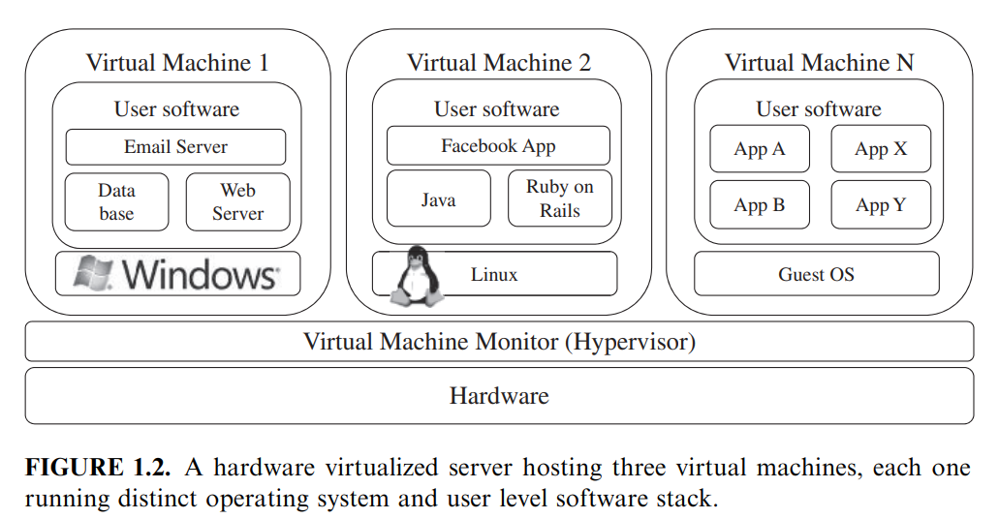
Hardware Virtualization
Hardware virtualization allows running multiple operating systems and software stacks on a single physical platform
The advent of several innovative technologies—multi-core chips, paravirtualization, hardware-assisted virtualization, and live migration of VMs
Traditionally, perceived benefits were improvements on sharing and utilization, better manageability, and higher reliability, the new are isolation, consolidation, and migration

Slide 8
VMWare ESXi.
  VMware is a pioneer in the virtualization market.
  It is a bare-metal hypervisor, meaning that it installs directly on the physical server
  It provides advanced virtualization techniques of processor, memory, and I/O. Especially, through memory ballooning and page sharing, it can overcommit memory, thus increasing the density of VMs inside a single physical server.
Xen.
  The Xen hypervisor started as an open-source project
  It has pioneered the para-virtualization concept, on which the guest operating system, by means of a specialized kernel, can interact with the hypervisor, thus significantly improving performance.
KVM.
  The kernel-based virtual machine (KVM) is a Linux virtualization subsystem.
  Activities such as memory management and scheduling are carried out by existing kernel
  KVM are simpler and smaller than hypervisors that take control of the entire machine
  KVM leverages hardware-assisted virtualization

Slide 9
Virtual Appliances and the Open Virtualization Format
An application combined with the environment needed to run it
Packaging application environments in the shape of virtual appliances eases software customization, configuration, and patching and improves portability.
On-line marketplaces have been set up to allow the exchange of ready-made appliances containing popular operating systems and useful software combinations, both commercial and open-source
The VMWare virtual appliance marketplace allows users to deploy appliances on VMWare hypervisors or on partners public clouds, and Amazon allows developers to share specialized Amazon Machine Images (AMI) and monetize their usage on Amazon EC2
In order to facilitate packing and distribution of software to be run on VMs several vendors, including VMware, IBM, Citrix, Cisco, Microsoft, Dell, and HP, have devised the Open Virtualization Format (OVF).
  It aims at being “open, secure, portable, efficient and extensible”
  An OVF package consists of a file, or set of files, describing the VM hardware characteristics (e.g., memory, network cards, and disks), operating system details, startup, and shutdown actions, the virtual disks themselves, and other metadata containing product and licensing information.

Slide 10
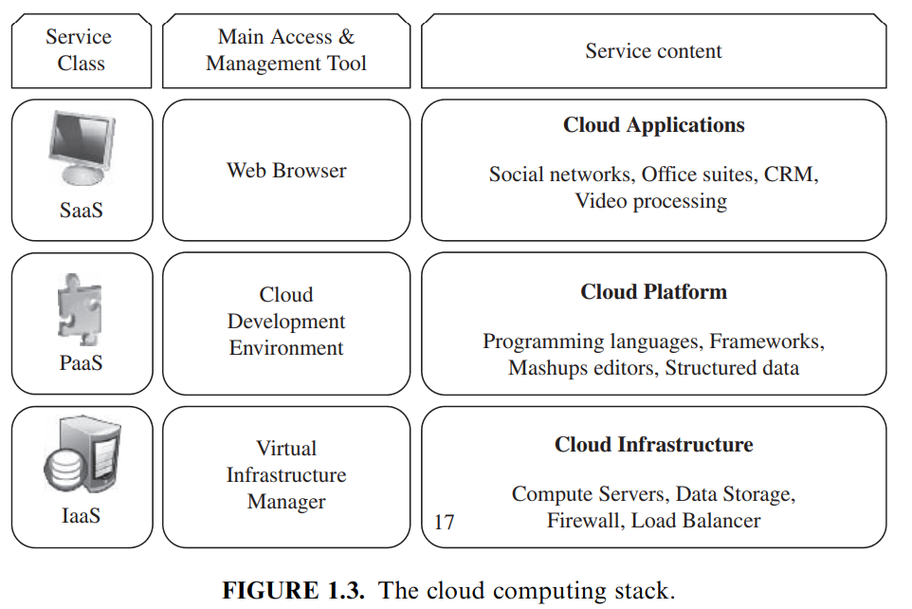
LAYERS AND TYPES OF CLOUDS
Cloud computing services are divided into three classes
According to the abstraction level of the capability provided and the service model of providers
(1) Infrastructure as a Service, (2) Platform as a Service, and (3) Software as a Service

Slide 11
Infrastructure as a Service:
  Offering virtualized resources (computation, storage, and communication) on demand
  Amazon Web Services mainly offers IaaS, means offering VMs with a software stack that can be customized similar to how an ordinary physical server would be customized.
  Users are given privileges to perform activities on to the server: starting and stopping it, customizing it by installing software packages, attaching virtual disks to it, and configuring access permissions and firewalls rules
Platform as a Service:
  Cloud platform offers an environment on which developers create and deploy applications and do not necessarily need to know how many processors or how much memory that applications will be using
  Google AppEngine, an example of Platform as a Service, offers a scalable environment for developing and hosting Web applications
Software as a Service:
  Applications reside on the top of the cloud stack.
  Services provided by this layer can be accessed by end users through Web portals.
  Therefore, consumers are increasingly shifting from locally installed computer programs to on-line software services that offer the same functionally. Traditional desktop applications such as word processing and spreadsheet can now be accessed as a service in the Web

Slide 12
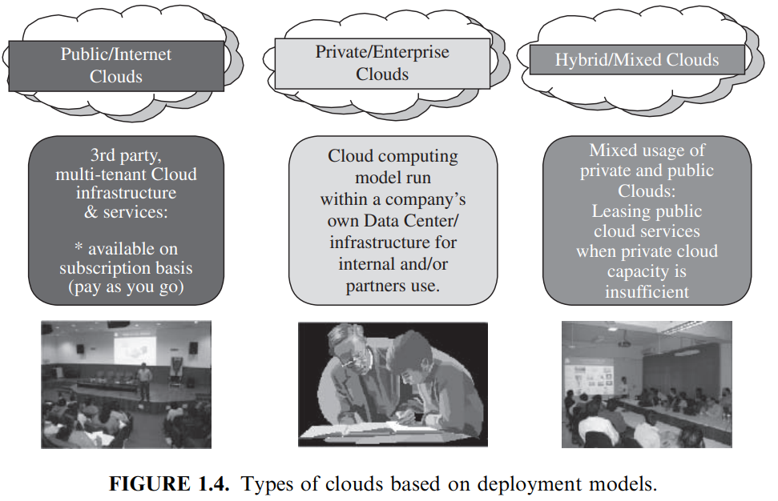
Deployment Models
Public cloud as a “cloud made available in a pay-as-you-go manner to the general public”
Private cloud as “internal data center of a business or other organization, not made available to the general public.”
Community cloud is “shared by several organizations and supports a specific community that has shared concerns (e.g., mission, security requirements, policy, and compliance considerations).”
Hybrid cloud takes shape when a private cloud is supplemented with computing capacity from public clouds . The approach of temporarily renting capacity to handle spikes in load is known as “cloud-bursting”

Slide 13
DESIRED FEATURES OF A CLOUD
Self-Service
Consumers expect on-demand, nearly instant access to resources.
To allow self-service access so that customers can request, customize, pay, and use services without intervention of human operators
Per-Usage Metering and Billing
It eliminates up-front commitment by users, allowing them to request and use only the necessary amount.
Services must be priced on a short-term basis (e.g., by the hour)
Allowing users to immediately release resources as soon as they are done.
Need to implement efficient trading of service such as pricing, accounting, and billing
Metering should be done accordingly for different types of service (e.g., storage, processing, and bandwidth)
Usage promptly reported, thus providing greater transparency.

Slide 14
DESIRED FEATURES OF A CLOUD
Elasticity
Cloud computing gives the illusion of infinite computing resources available on demand.
Therefore users expect clouds to rapidly provide resources in any quantity at any time.
In particular, it is expected that the additional resources can be
    provisioned, possibly automatically, when an application load increases and
    released when load decreases (scale up and down)
  Customization
  In a multi-tenant cloud a great disparity between user needs is often the case.
  Thus, resources rented from the cloud must be highly customizable.
  In the case of infrastructure services, customization means allowing users to deploy specialized virtual appliances and to be given privileged (root) access to the virtual servers.
  Other service classes (PaaS and SaaS) offer less flexibility and are not suitable for general-purpose computing, but still are expected to provide a certain level of customization.

Slide 15
CLOUD INFRASTRUCTURE MANAGEMENT
Managing physical and virtual resources, namely servers, storage, and networks
The orchestration of resources must be performed in a way to rapidly and dynamically provision resources to applications
The software toolkit responsible for this orchestration is called a virtual infrastructure manager (VIM)
It resembles traditional operating system—but instead of single computer, it aggregates resources from multiple computers, presenting a uniform view to user and applications.
The term “cloud operating system”, “infrastructure sharing software ” and “virtual infrastructure engine “ are also used

Slide 16
Basic and advanced features in VIMs
Virtualization Support:
  The multi-tenancy aspect of clouds requires multiple customers with disparate requirements to be served by a single hardware infrastructure.
  Virtualized resources (CPUs, memory, etc.) can be sized and resized with certain flexibility.
  These features make hardware virtualization, the ideal technology to create a virtual infrastructure that partitions a data center among multiple tenants.
Self-Service, On-Demand Resource Provisioning:
  Self-service access to resources has been perceived as one the most attractive features of clouds.
  It enables users to directly obtain services from clouds, such as spawning the creation of a server and tailoring its software, configurations, and security policies, without interacting with a human system administrator.
  This capability “eliminates the need for more time-consuming, labor-intensive, human-driven procurement processes familiar to many in IT”.
  Therefore, exposing a self-service interface, through which users can easily interact with the system, is a highly desirable feature of a VI manager.

Slide 17
Basic and advanced features in VIMs
Multiple Backend Hypervisors:
Different virtualization models and tools offer different benefits, drawbacks, and limitations.
VI managers provide a uniform management layer regardless of the virtualization technology used.
This characteristic is more visible in open-source VI managers, which usually provide pluggable drivers to interact with multiple hypervisors.
Storage Virtualization:
Virtualizing storage means abstracting logical storage from physical storage.
By consolidating all available storage devices in a data center, it allows creating virtual disks independent from device and location.
Storage devices are commonly organized in a storage area network (SAN) and attached to servers via protocols such as Fibre Channel, iSCSI, and NFS

Slide 18
Basic and advanced features in VIMs
Interface to Public Clouds:
Researchers have perceived that extending the capacity of a local in-house computing infrastructure by borrowing resources from public clouds is advantageous.
In this fashion, institutions can make good use of their available resources and, in case of spikes in demand, extra load can be offloaded to rented resources.
A VI manager can be used in a hybrid cloud setup if it offers a driver to manage the life cycle of virtualized resources obtained from external cloud providers.
To the applications, the use of leased resources must ideally be transparent.
Virtual Networking:
Virtual networks allow creating an isolated network on top of a physical infrastructure independently from physical topology and locations.
A virtual LAN (VLAN) allows isolating traffic that shares a switched network, allowing VMs to be grouped into the same broadcast domain.
Additionally, a VLAN can be configured to block traffic originated from VMs from other networks.
Similarly, the VPN (virtual private network) concept is used to describe a secure and private overlay network on top of a public network (most commonly the public Internet).
VI managers that interface with public clouds often support secure VPNs connecting local and remote VMs.

Slide 19
Basic and advanced features in VIMs
Dynamic Resource Allocation:
  For energy consumption in data centers dynamic consolidating VMs in a fewer number of servers is done.
  In cloud infrastructures, where applications have variable and dynamic needs, capacity management and demand prediction are complicated.
  This triggers the need for dynamic resource allocation aiming at obtaining a timely match of supply and demand.
  Energy consumption reduction and better management of SLAs can be achieved by dynamically remapping VMs to physical machines at regular intervals.
  Machines that are not assigned any VM can be turned off or put on a low power state.
  In the same fashion, overheating can be avoided by moving load away from hotspots
  A number of VI managers include a dynamic resource allocation feature that continuously monitors utilization across resource pools and reallocates available resources among VMs according to application needs.
Virtual Clusters:
Several VI managers can holistically manage groups of VMs.
This feature is useful for provisioning computing virtual clusters on demand, and interconnected VMs for multi-tier Internet applications

Slide 20
Basic and advanced features in VIMs
Reservation and Negotiation Mechanism:
  When users request computational resources to available at a specific time, requests are termed advance reservations (AR)
  Best-effort requests, when users request resources whenever available.
  To support complex requests, such as AR, a VI manager must allow users to “lease” resources expressing more complex terms (e.g., the period of time of a reservation).
  This is especially useful in clouds on which resources are scarce;
  Since not all requests may be satisfied immediately, they can benefit of VM placement strategies that support queues, priorities, and advance reservations.
  Additionally, leases may be negotiated and renegotiated, allowing provider and consumer to modify a lease or present counter proposals until an agreement is reached.
  This feature is illustrated by the case in which an AR request for a given slot cannot be satisfied, but the provider can offer a distinct slot that is still satisfactory to the user. This problem has been addressed in OpenPEX, which incorporates a bilateral negotiation protocol that allows users and providers to come to an alternative agreement by exchanging offers and counter offers.

Slide 21
Basic and advanced features in VIMs
High Availability and Data Recovery:
The high availability (HA) feature of VI managers aims at minimizing application downtime and preventing business disruption.
A few VI managers accomplish this by providing a failover mechanism, which detects failure of both physical and virtual servers and restarts VMs on healthy physical servers.
This style of HA protects from host, but not VM, failures.
For mission critical applications, when a failover solution involving restarting VMs does not suffice, additional levels of fault tolerance that rely on redundancy of VMs are implemented.
In this style, redundant and synchronized VMs (running or in standby) are kept in a secondary physical server.
The HA solution monitors failures of system components such as servers, VMs, disks, and network and ensures that a duplicate VM serves the application in case of failures.
Data backup in clouds should take into account the high data volume involved in VM management.
Frequent backup of a large number of VMs, each one with multiple virtual disks attached, should be done with minimal interference in the systems performance.
In this sense, some VI managers offer data protection mechanisms that perform incremental backups of VM images.
The backup workload is often assigned to proxies, thus offloading production server and reducing network overhead [59].

Slide 22
INFRASTRUCTURE AS A SERVICE PROVIDERS
The most relevant features are:
geographic distribution of data centers;
variety of user interfaces and APIs to access the system;
specialized components and services that aid particular applications (e.g., load balancers, firewalls);
choice of virtualization platform and operating systems; and
different billing methods and period (e.g., prepaid vs. post-paid, hourly vs. monthly)

Slide 23
INFRASTRUCTURE AS A SERVICE PROVIDERS
Geographic Presence:
To improve availability and responsiveness, a provider of worldwide services would typically build several data centers distributed around the world.
For example, Amazon Web Services presents the concept of “availability zones” and “regions” for its service.
Availability zones are “distinct locations that are engineered to be insulated from failures in other availability zones and provide inexpensive, low-latency network connectivity to other availability zones in the same region.”
Regions, in turn, “are geographically dispersed and will be in separate geographic areas or countries.”
User Interfaces and Access to Servers:
IaaS must provide multiple access means to its cloud, thus catering for various users and their preferences.
Different types of user interfaces (UI) provide different levels of abstraction, the most common being graphical user interfaces (GUI), command-line tools (CLI), and Web service (WS) APIs

Slide 24
INFRASTRUCTURE AS A SERVICE PROVIDERS
Advance Reservation of Capacity:
  Advance reservations allow users to request for an IaaS provider to reserve resources for a specific time frame in the future
  However, most clouds only support best-effort requests; that is, users requests are server whenever resources are available.
  Amazon Reserved Instances is a form of advance reservation of capacity, allowing users to pay a fixed amount of money in advance to guarantee resource availability at anytime during an agreed period
  And then paying a discounted hourly rate when resources are in use.
  However, only long periods of 1 to 3 years are offered;
Automatic Scaling and Load Balancing:
  Elasticity is a key characteristic of the cloud computing model.
  Applications often need to scale up and down to meet varying load conditions.
  Automatic scaling is a highly desirable feature of IaaS clouds.
  It allow users to set conditions for when they want their applications to scale up and down
  Based on application-specific metrics such as transactions per second, number of simultaneous users, request latency, and so forth.
  When the number of virtual servers is increased by automatic scaling, incoming traffic must be automatically distributed among the available servers.
  This activity enables applications to promptly respond to traffic increase while also achieving greater fault tolerance

Slide 25
INFRASTRUCTURE AS A SERVICE PROVIDERS
Service-Level Agreement:
  Service-level agreements (SLAs) are offered by IaaS providers to express their commitment to delivery of a certain QoS.
  To customers it serves as a warranty.
  An SLA usually include availability and performance guarantees.
  Additionally, metrics must be agreed upon by all parties as well as penalties for violating these expectations.
  Most IaaS providers focus their SLA terms on availability guarantees, specifying the minimum percentage of time the system will be available during a certain period.
  For instance, Amazon EC2 states that “if the annual uptime Percentage for a customer drops below 99.95% for the service year, that customer is eligible to receive a service credit equal to 10% of their bill.”

Slide 26
INFRASTRUCTURE AS A SERVICE PROVIDERS
Hypervisor and Operating System Choice:
  Traditionally, IaaS offerings have been based on heavily customized open-source Xen deployments.
  IaaS providers needed expertise in Linux, networking, virtualization, metering, resource management, and many other low-level aspects to successfully deploy and maintain their cloud offerings.
  More recently, there has been an emergence of turnkey IaaS platforms such as VMWare vCloud, and Citrix Cloud Center (C3) which have lowered the barrier of entry for IaaS competitors, leading to a rapid expansion in the IaaS marketplace

Slide 27
PLATFORM AS A SERVICE PROVIDERS
Public Platform as a Service providers commonly offer a development and deployment environment that allow users to create and run their applications with little or no concern to low-level details of the platform.
In addition, specific programming languages and frameworks are made available in the platform, as well as other services such as persistent data storage and in memory cache

Slide 28
PLATFORM AS A SERVICE PROVIDERS
Programming Models, Languages, and Frameworks:
  Each model aims at efficiently solving a particular problem.
  In the cloud computing domain, the most common activities that require specialized models are:
    processing of large dataset in clusters of computers (MapReduce model),
    development of request-based Web services and applications;
    definition and orchestration of business processes in the form of workflows (Workflow model); and
    high-performance distributed execution of various computational tasks.
  PaaS providers usually support multiple programming languages.
  Most commonly used languages in platforms include Python and Java (e.g., Google AppEngine), .NET languages (e.g., Microsoft Azure), and Ruby (e.g., Heroku).
  Force.com has devised its own programming language (Apex) and an Excel-like query language, which provide higher levels of abstraction to key platform functionalities.
  A variety of software frameworks are usually made available to PaaS developers, depending on application focus.
  Providers that focus on Web and enterprise application hosting offer popular frameworks such as Ruby on Rails, Spring, Java EE, and .NET

Slide 29
PLATFORM AS A SERVICE PROVIDERS
Persistence Options:
A persistence layer is essential to allow applications to record their state and recover it in case of crashes
And to store user data.
Traditionally, Web and enterprise application developers have chosen relational databases as the preferred persistence method.
These databases offer fast and reliable structured data storage and transaction processing,
But may lack scalability to handle several petabytes of data stored in commodity computers.
Distributed storage technologies have emerged, which seek to be robust and highly scalable, at the expense of relational structure and convenient query languages.
For example, Amazon Simple DB and Google AppEngine datastore offer schema-less, automatically indexed database services.
Data queries can be performed only on individual tables; that is, join operations are unsupported for the sake of scalability.

Slide 30
CHALLENGES AND RISKS
Despite the initial success and popularity of the cloud computing paradigm and the extensive availability of providers and tools, a significant number of challenges and risks are inherent to this new model of computing.
Providers, developers, and end users must consider these challenges and risks to take good advantage of cloud computing.
Issues to be faced include user privacy, data security, data lock-in, availability of service, disaster recovery, performance, scalability, energy-efficiency, and programmability

Slide 31
Security, Privacy, and Trust:
  Information security as a main issue: “current cloud offerings are essentially public ... exposing the system to more attacks.”
  For this reason there are potentially additional challenges to make cloud computing environments as secure as in-house IT systems.
  Security and privacy affect the entire cloud computing stack, since there is a massive use of third-party services and infrastructures that are used to host important data or to perform critical operations.
  In this scenario, the trust toward providers is fundamental to ensure the desired level of privacy for applications hosted in the cloud.
  Legal and regulatory issues also need attention.
  When data are moved into the Cloud, providers may choose to locate them anywhere on the planet.
  The physical location of data centers determines the set of laws that can be applied to the management of data.
  For example, specific cryptography techniques could not be used because they are not allowed in some countries. Similarly, country laws can impose that sensitive data, such as patient health records, are to be stored within national borders

Slide 32
Data Lock-In and Standardization:
A major concern of cloud computing users is about having their data locked-in by a certain provider.
Users may want to move data and applications out from a provider that does not meet their requirements.
However, in their current form, cloud computing infrastructures and platforms do not employ standard methods of storing user data and applications.
Consequently, they do not interoperate and user data are not portable.
The answer to this concern is standardization.
In this direction, there are efforts to create open standards for cloud computing.
The Cloud Computing Interoperability Forum (CCIF) was formed by organizations such as Intel, Sun, and Cisco.
The development of the Unified Cloud Interface (UCI) by CCIF aims at creating a standard programmatic point of access to an entire cloud infrastructure.
In the hardware virtualization sphere, the Open Virtual Format (OVF) aims at facilitating packing and distribution of software to be run on VMs so that virtual appliances can be made portable

Slide 33
Availability, Fault-Tolerance, and Disaster Recovery:
  It is expected that users will have certain expectations about the service level to be provided once their applications are moved to the cloud.
  These expectations include availability of the service, its overall performance, and what measures are to be taken when something goes wrong in the system or its components.
  In summary, users seek for a warranty before they can comfortably move their business to the cloud. SLAs, which include QoS requirements, must be ideally set up between customers and cloud computing providers to act as warranty.
  An SLA specifies the details of the service to be provided, including availability and performance guarantees.
  Additionally, metrics must be agreed upon by all parties, and penalties for violating the expectations must also be approved.

Slide 34
Resource Management and Energy-Efficiency:
One important challenge faced by providers of cloud computing services is the efficient management of virtualized resource pools.
Physical resources such as CPU cores, disk space, and network bandwidth must be sliced and shared among virtual machines running potentially heterogeneous workloads.
The multi-dimensional nature of virtual machines complicates the activity of finding a good mapping of VMs onto available physical hosts while maximizing user utility.
Dimensions to be considered include: number of CPUs, amount of memory, size of virtual disks, and network bandwidth.
Dynamic VM mapping policies may leverage the ability to suspend, migrate, and resume VMs as an easy way of preempting low-priority allocations in favor of higher-priority ones.
Migration of VMs also brings additional challenges such as detecting when to initiate a migration, which VM to migrate, and where to migrate.
In addition, policies may take advantage of live migration of virtual machines to relocate data center load without significantly disrupting running services.
In this case, an additional concern is the trade-off between the negative impact of a live migration on the performance and stability of a service and the benefits to be achieved with that migration.

Slide 35
Another challenge concerns the outstanding amount of data to be managed in various VM management activities.
Such data amount is a result of particular abilities of virtual machines, including the ability of traveling through space (i.e., migration) and time (i.e., checkpointing and rewinding), operations that may be required in load balancing, backup, and recovery scenarios.
In addition, dynamic provisioning of new VMs and replicating existing VMs require efficient mechanisms to make VM block storage devices (e.g., image files) quickly available at selected hosts.
Data centers consumes large amounts of electricity.
According to a data published by HP [4], 100 server racks can consume 1.3 MW of power and another 1.3 MW are required by the cooling system, thus costing USD 2.6 million per year.
Besides the monetary cost, data centers significantly impact the environment in terms of CO2 emissions from the cooling systems.
In addition to optimize application performance, dynamic resource management can also improve utilization and consequently minimize energy consumption in data centers.
This can be done by judiciously consolidating workload onto smaller number of servers and turning off idle resources.

